Slide 1


Network Anomaly Detection in Cloud-based Management Services using AI
SALVIN THILAK SADASIVAN – 1270667
MABHARA TINEYI - 1270667
(Group No.: 38)

Slide 2

RECAP
small

Slide 3
RECAP
Existing systems face challenges such as high computational complexity and false-positive rates.
What is Data MIRRORING? Anomaly Detection using Data Mirroring.
Challenges in anomaly detection.
Possible Solutions ( ImGWO & ImCNN )
Benefits of AI-Driven Anomaly Detection.

Slide 4



Dataset
TON_IoT Dataset ( Intelligence Security Group UNSW Canberra at ADFA )
Canadian Institute for Cybersecurity

Slide 5
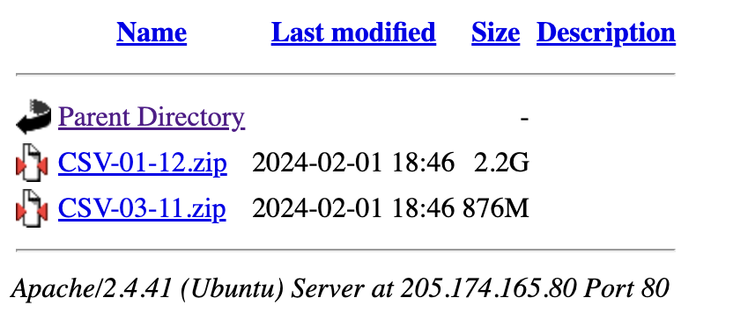
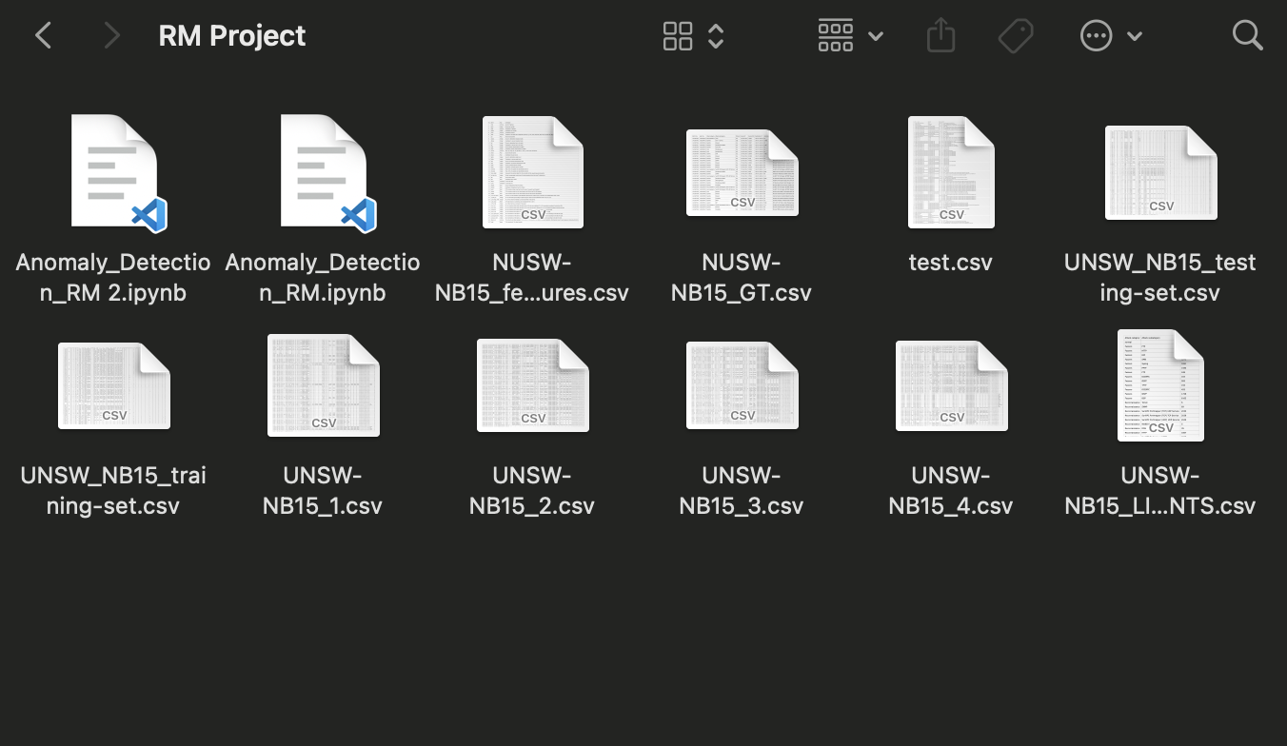
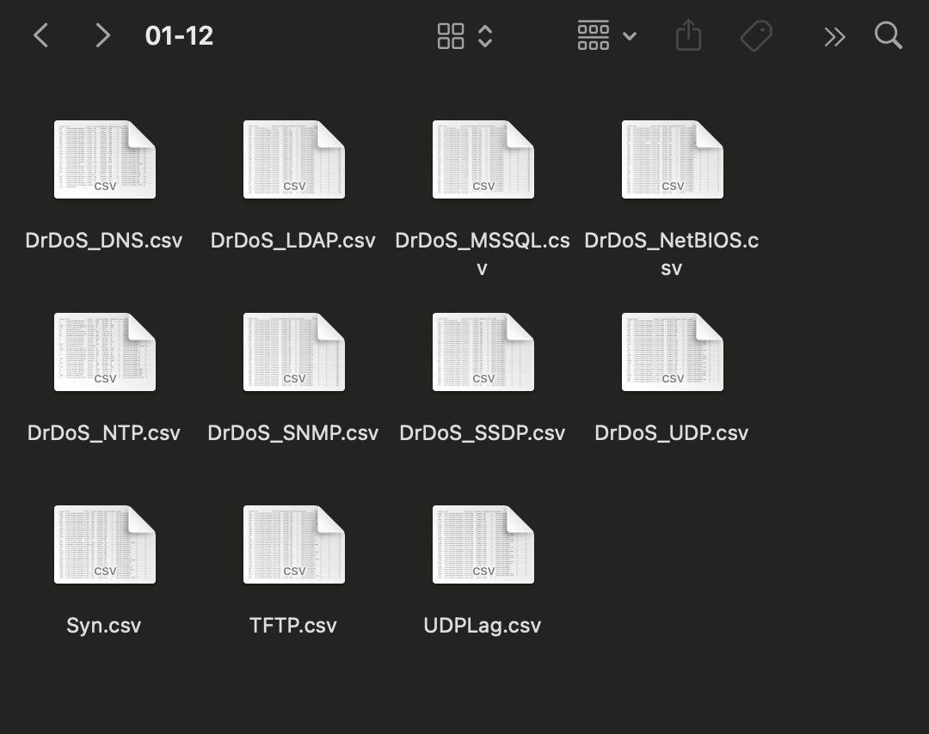
TON_IoT Dataset

Slide 6
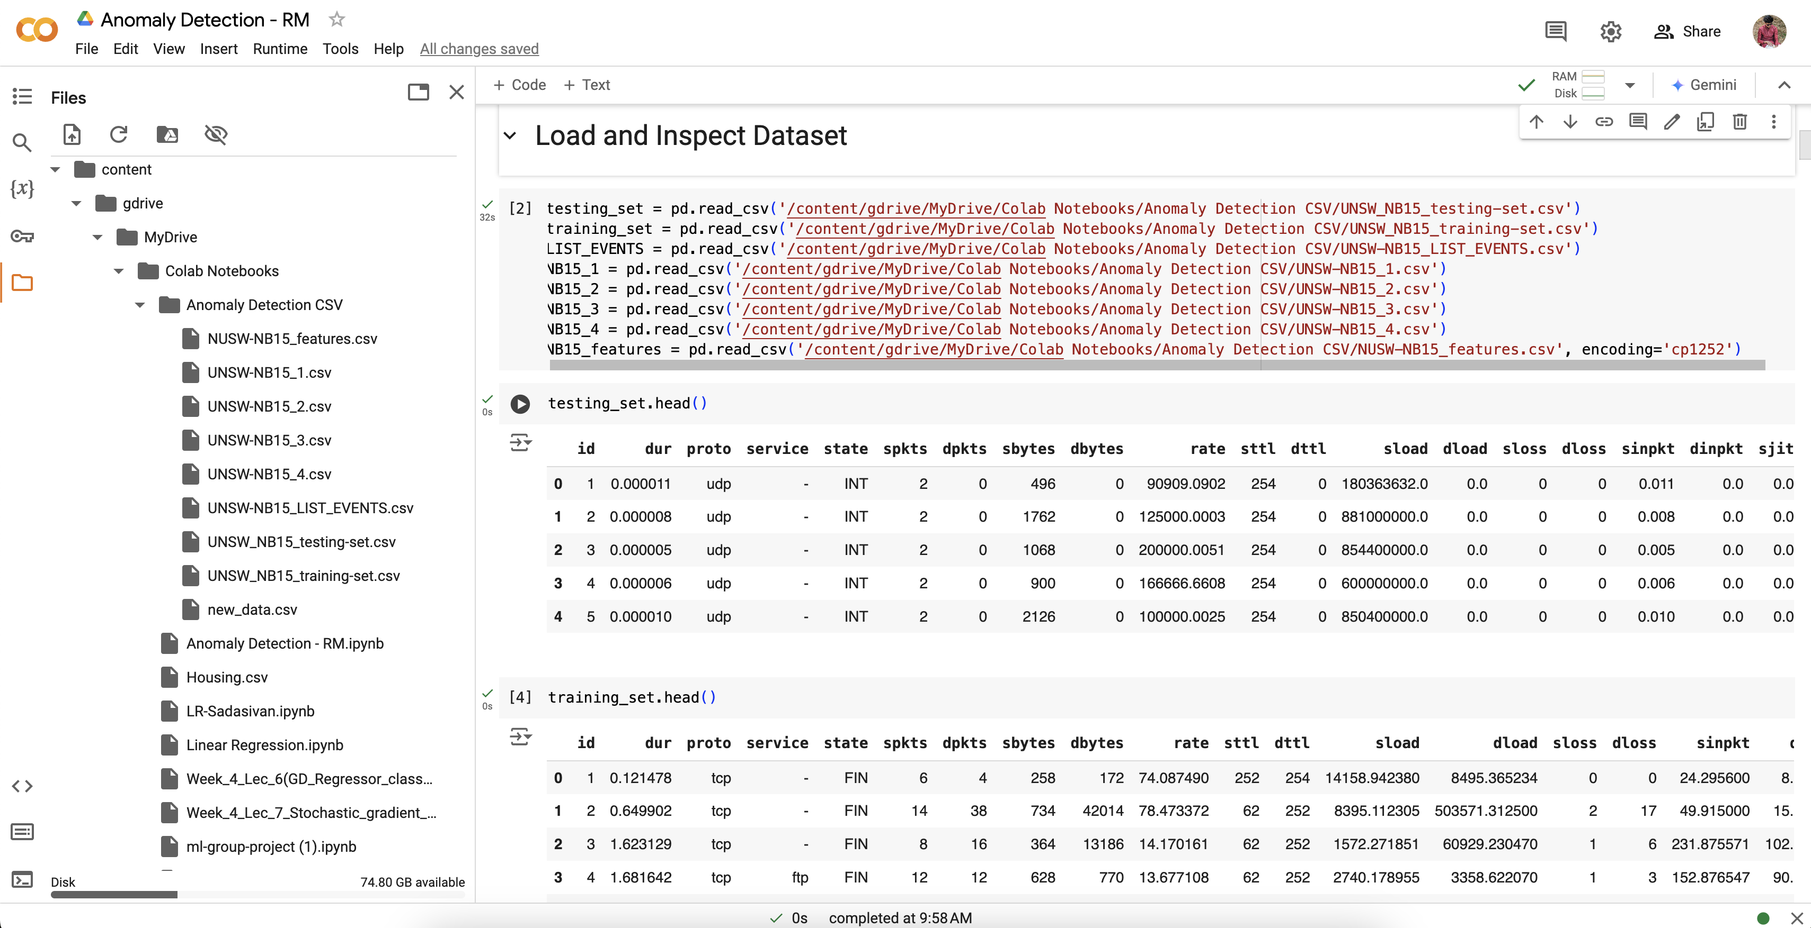

Slide 7
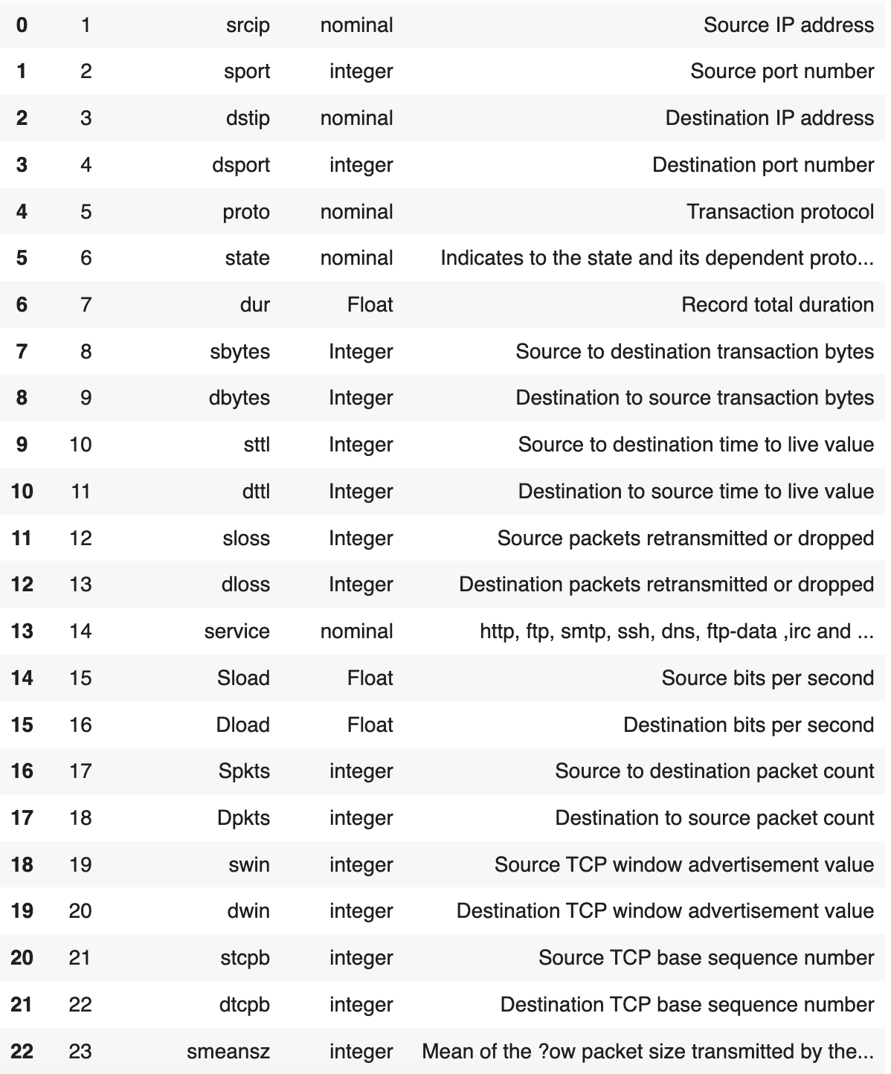
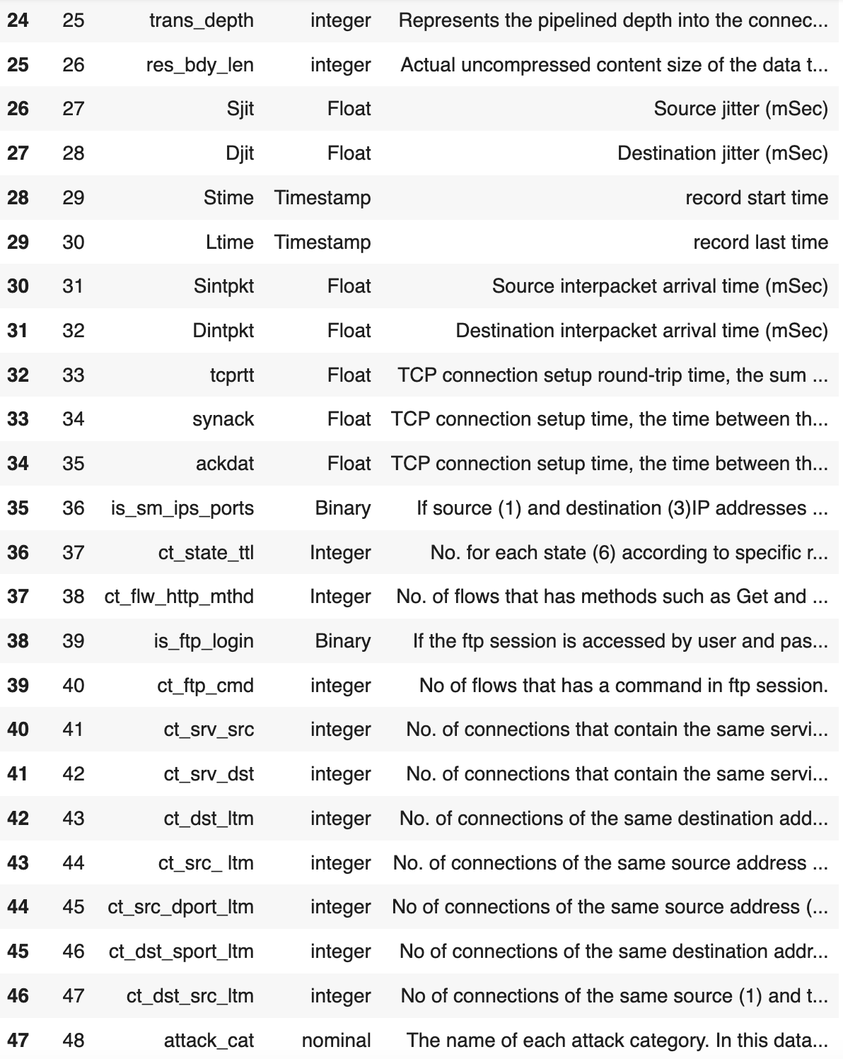
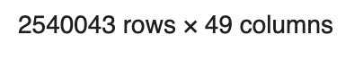

Slide 8
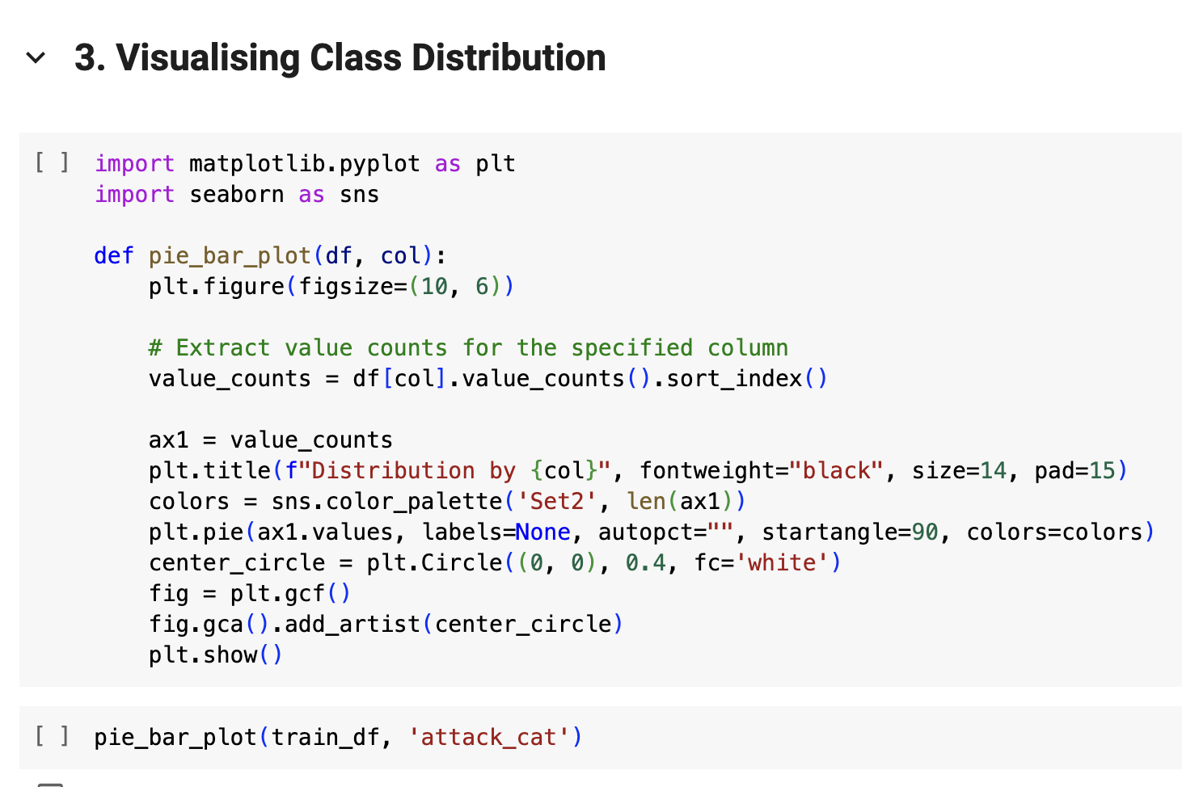
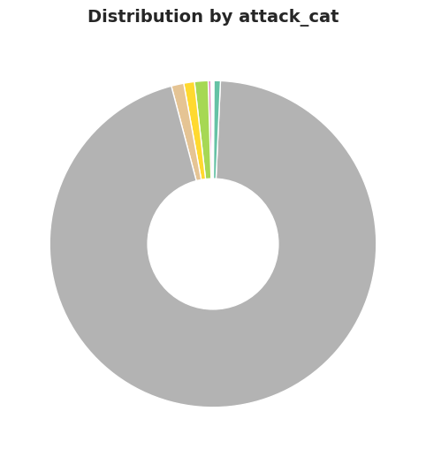

Slide 9
Type of data
Normal ( 1959771 ) - The data are symmetrically distributed with no skew.
Exploits ( 27600 ) - An exploit is a method or piece of code that takes advantage of software, applications, networks, OS, or hardware vulnerabilities, typically for malicious purposes.
Backdoor ( 1684 ) - A backdoor is a typically covert method of bypassing normal authentication or encryption in a computer, product, or embedded device (e.g. a home router)
Fuzzers ( 21795 ) - It refers to intentionally invalid, unexpected, or random data that is used in a software testing technique called "fuzzing" to deliberately try to crash a program or trigger unexpected behaviour, thereby identifying potential vulnerabilities in the software by feeding it with abnormal inputs.
DoS ( 5665 ) - A denial-of-service (DoS) attack is a cyber-attack that aims to make a network, service, or website inaccessible or degrade its performance
Reconnaissance ( 13357 ) - reconnaissance is gathering information about a system or entity before attempting an attack. It can also be referred to as footprinting.
shellcode ( 1511 ) - shellcode is a small piece of code that is used to exploit a software vulnerability and take control of a compromised machine.
worms ( 171 ) - a worm is a type of malware that can spread itself to other computers without the need for human interaction.
generic ( 25378 ) - it is not owned by a single user it may be used by multiple people. A generalization of conventional data models that define standardized relation types and what can be related by those types.
analysis ( 2185 ) - information to understand and mitigate security risks.

Slide 10
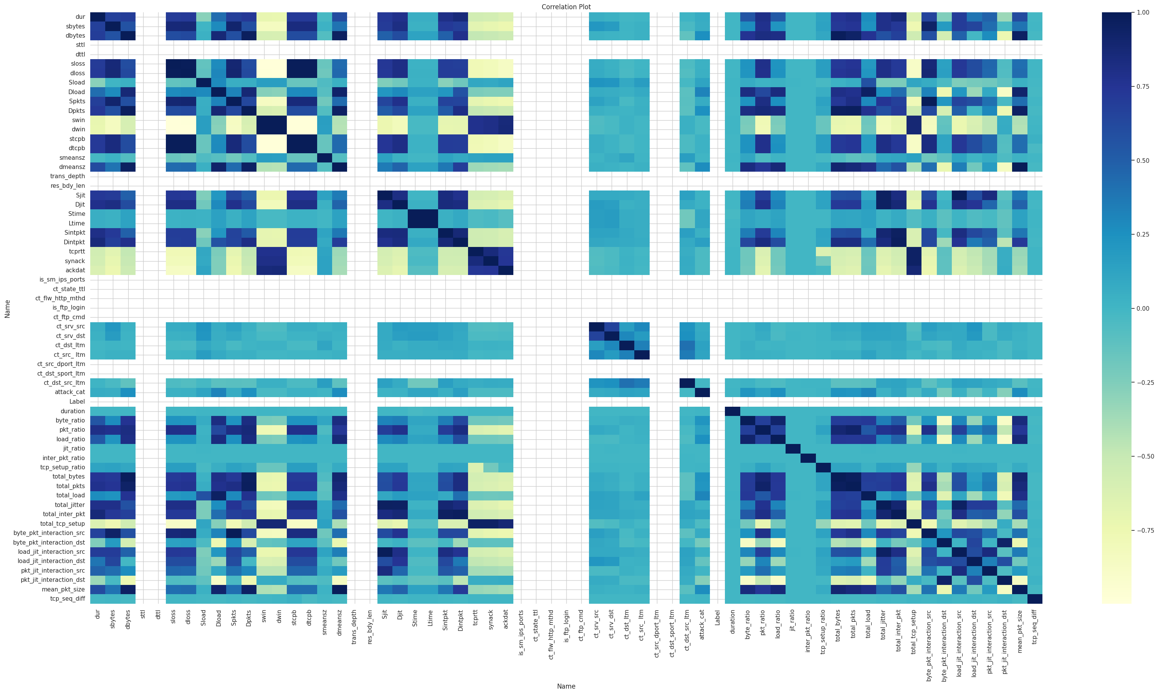

Slide 11
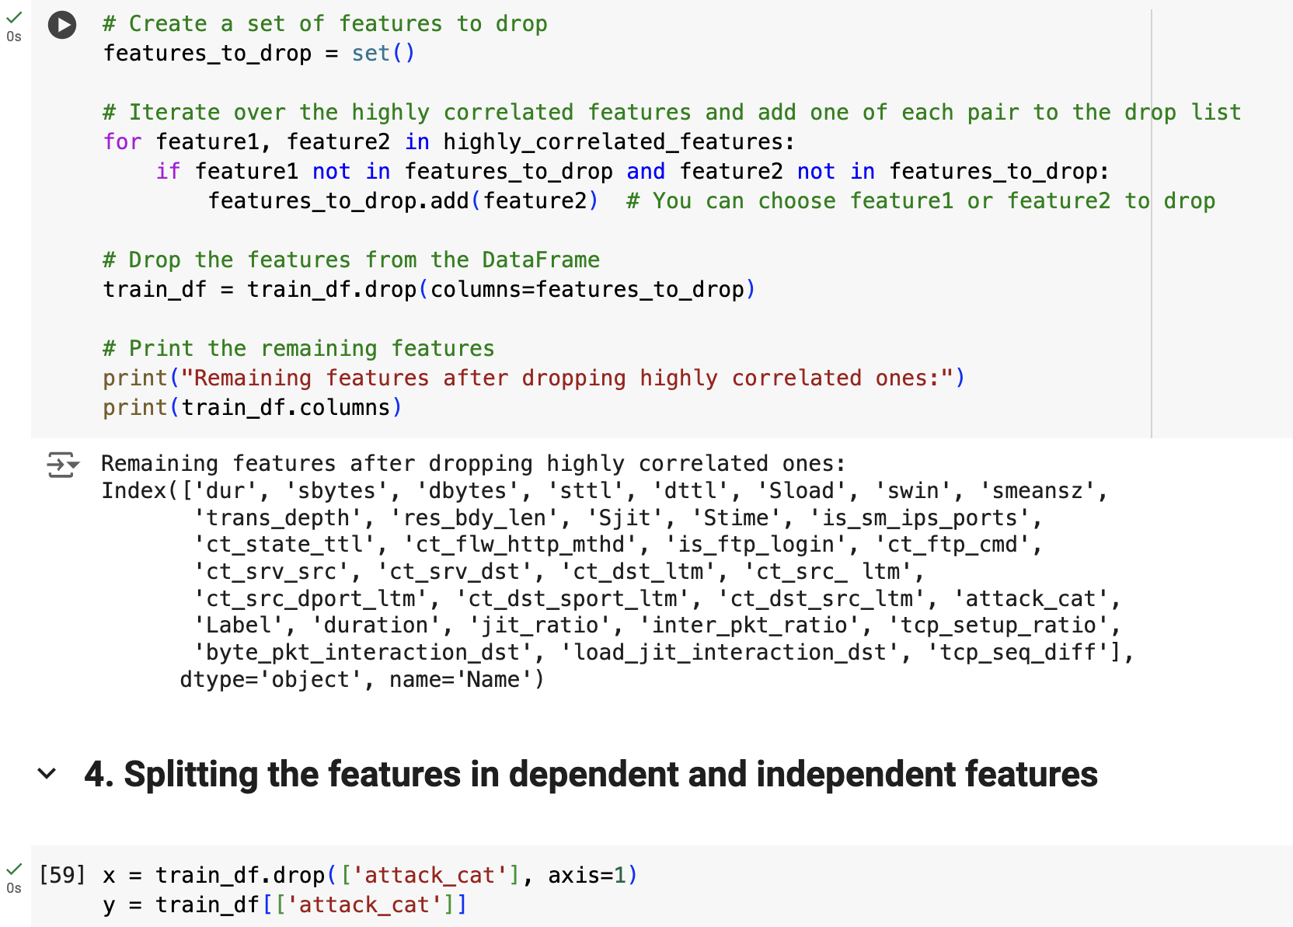
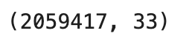

Slide 12
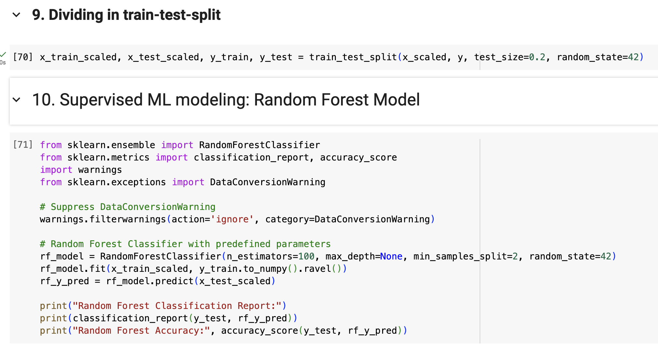

Slide 13
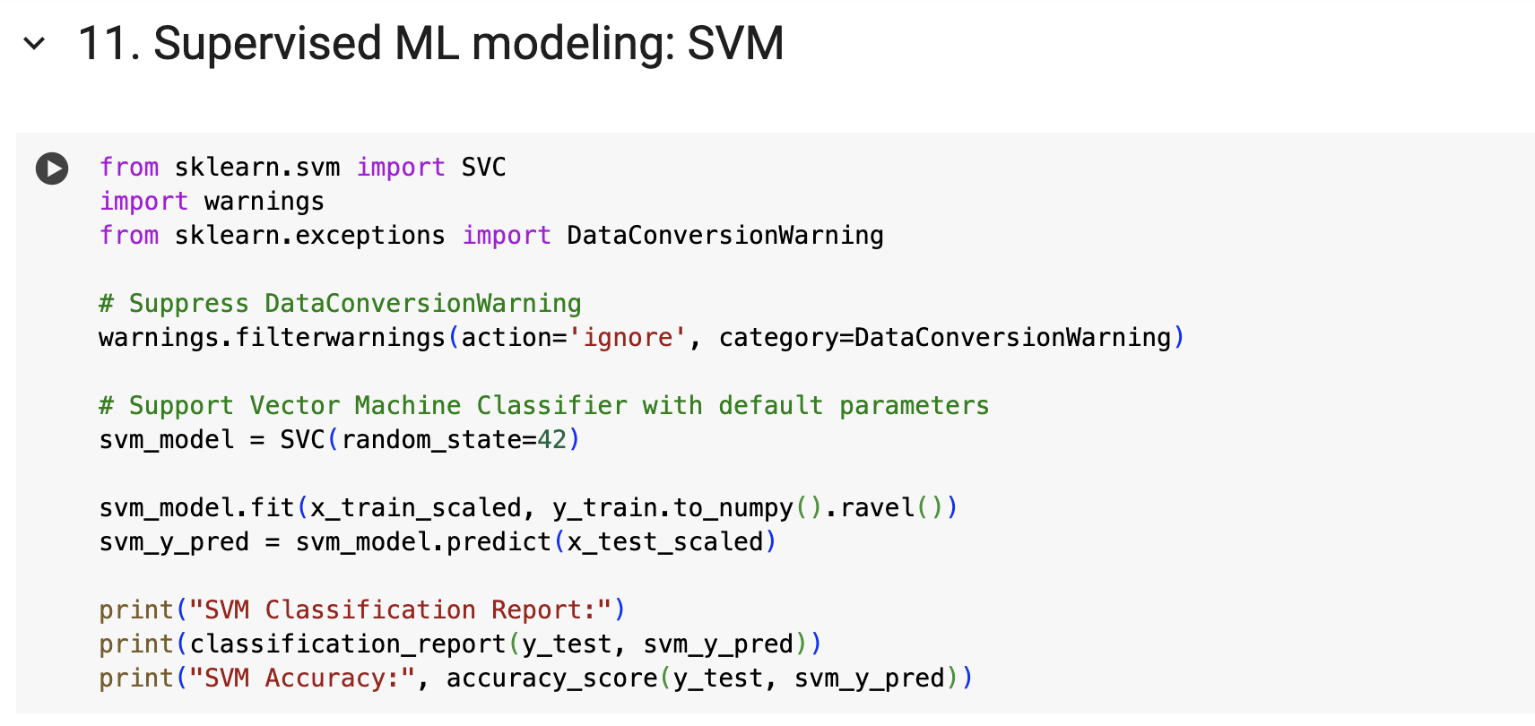
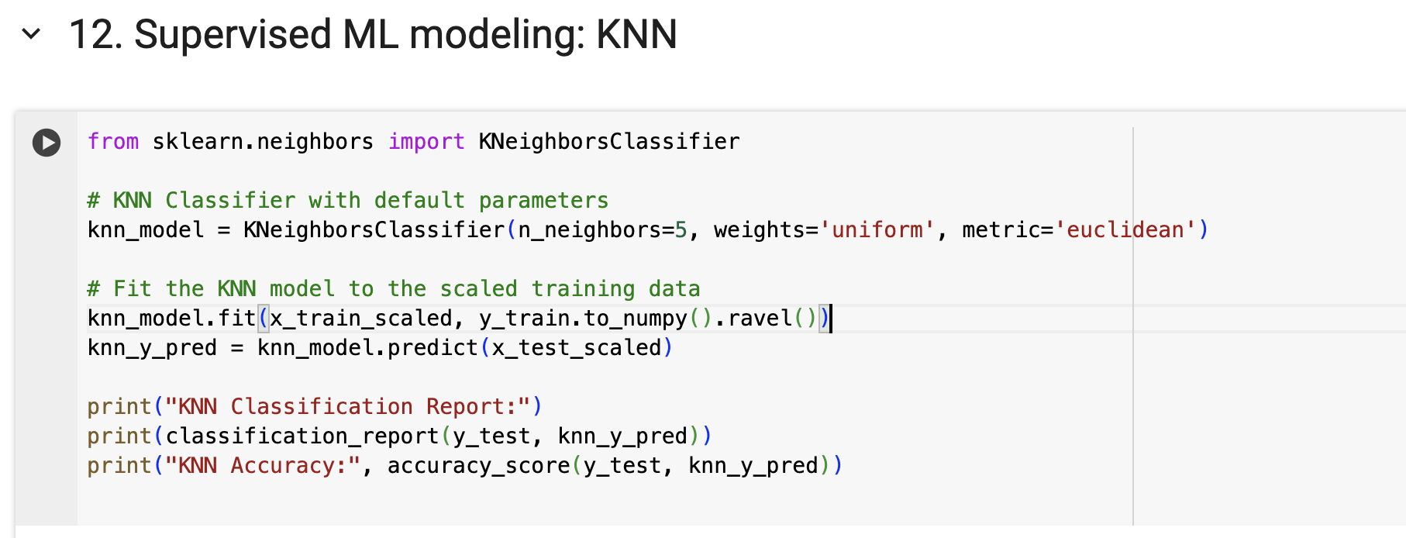

Slide 14
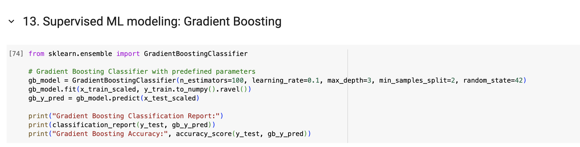

Slide 15
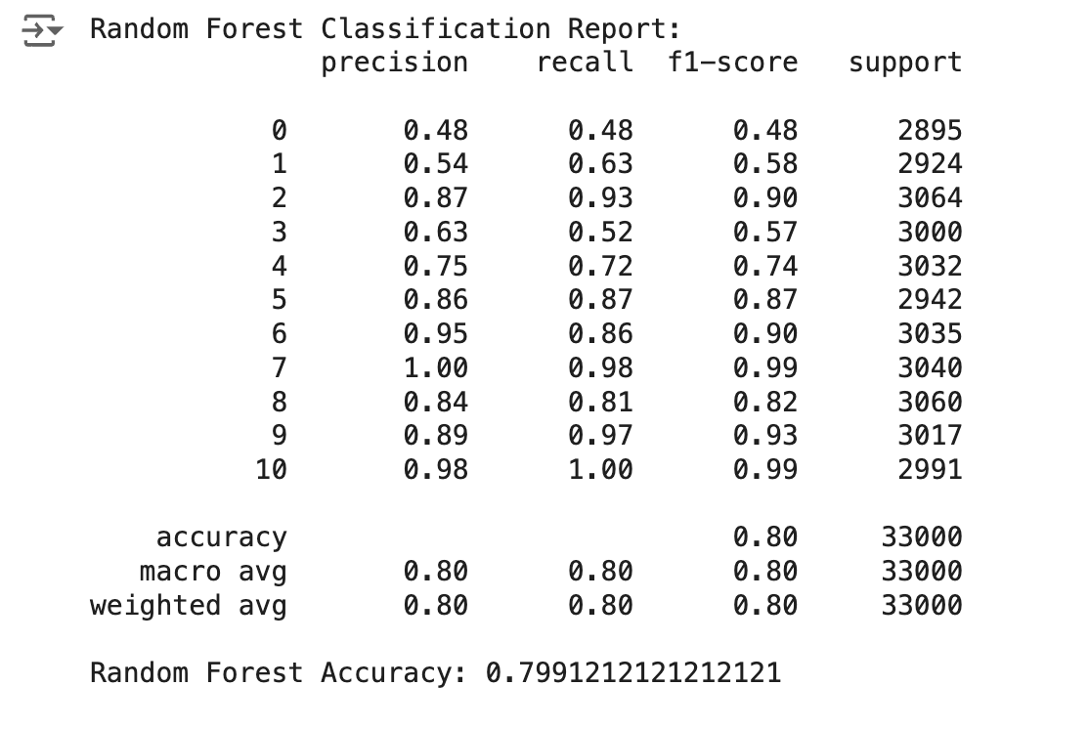
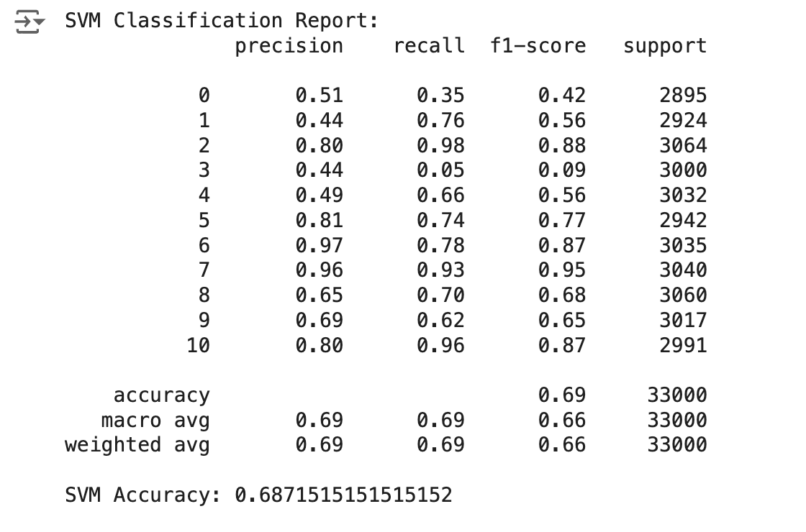
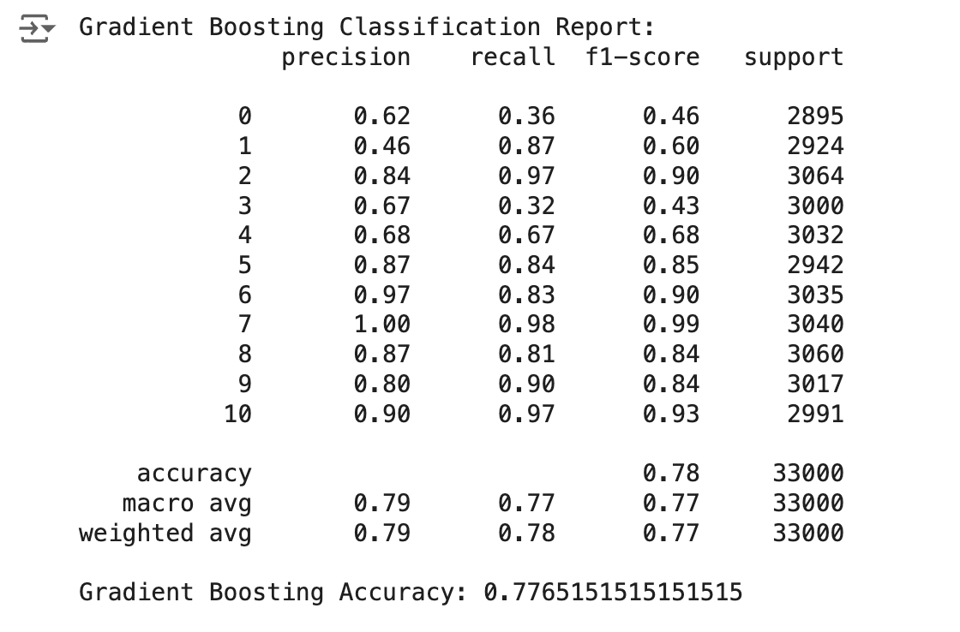
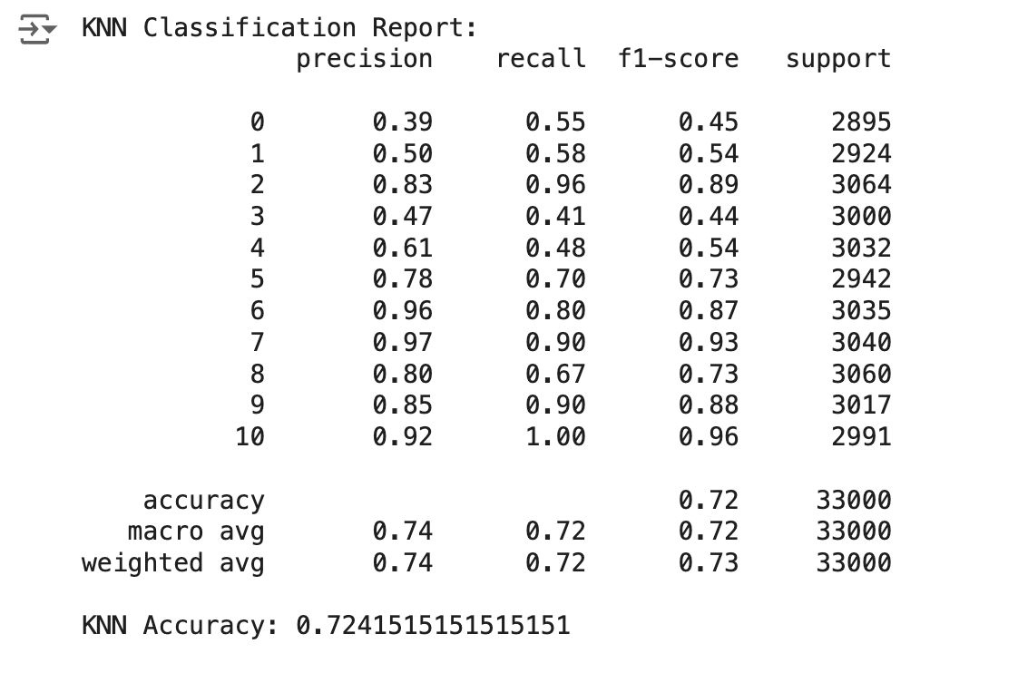

Slide 16
ImGWO
Improved Grey Wolf Optimizer

Slide 17
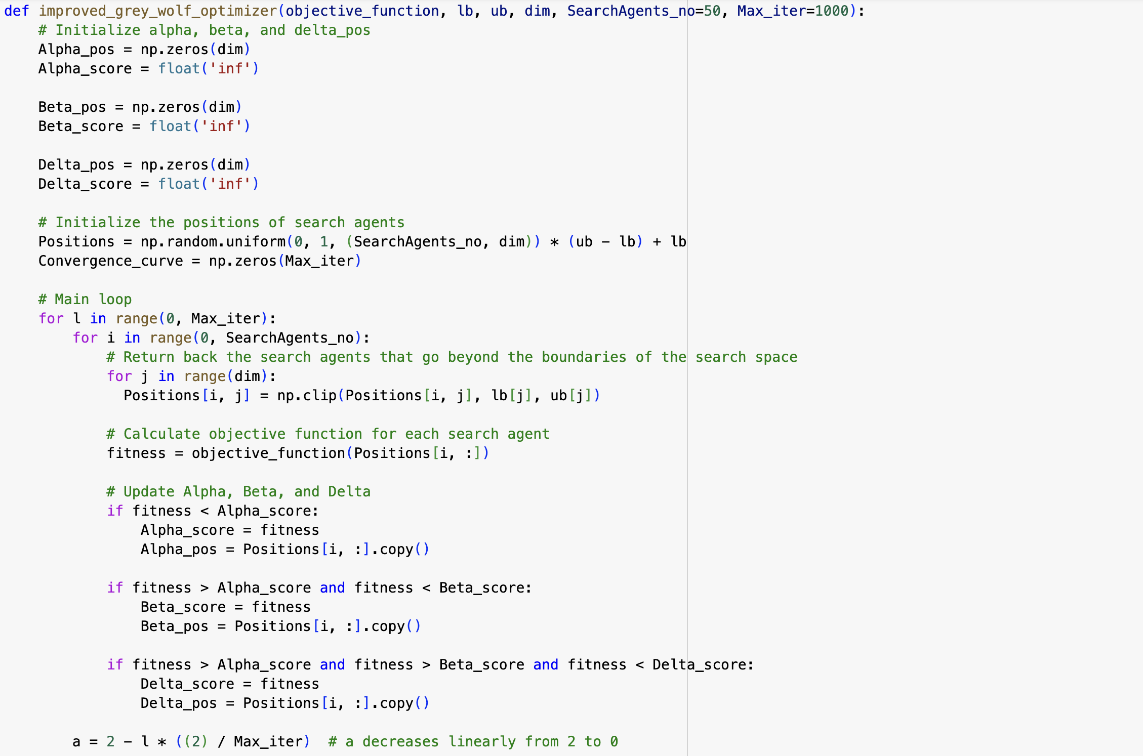

Slide 18
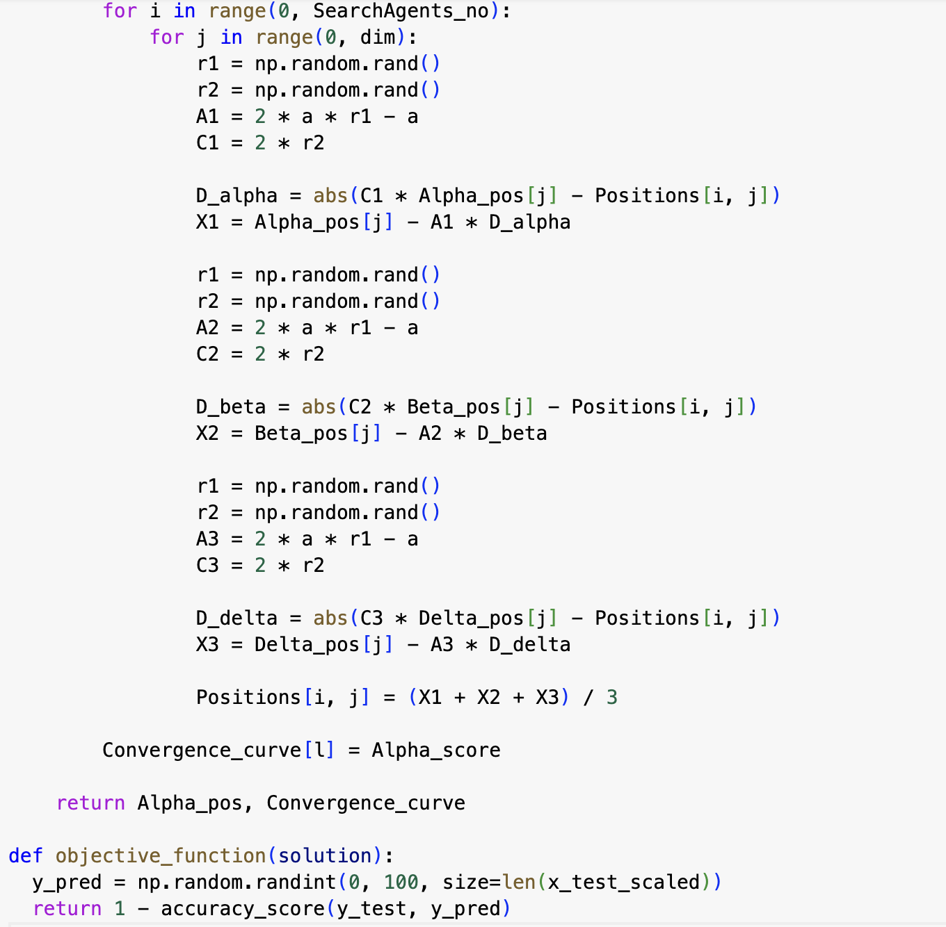
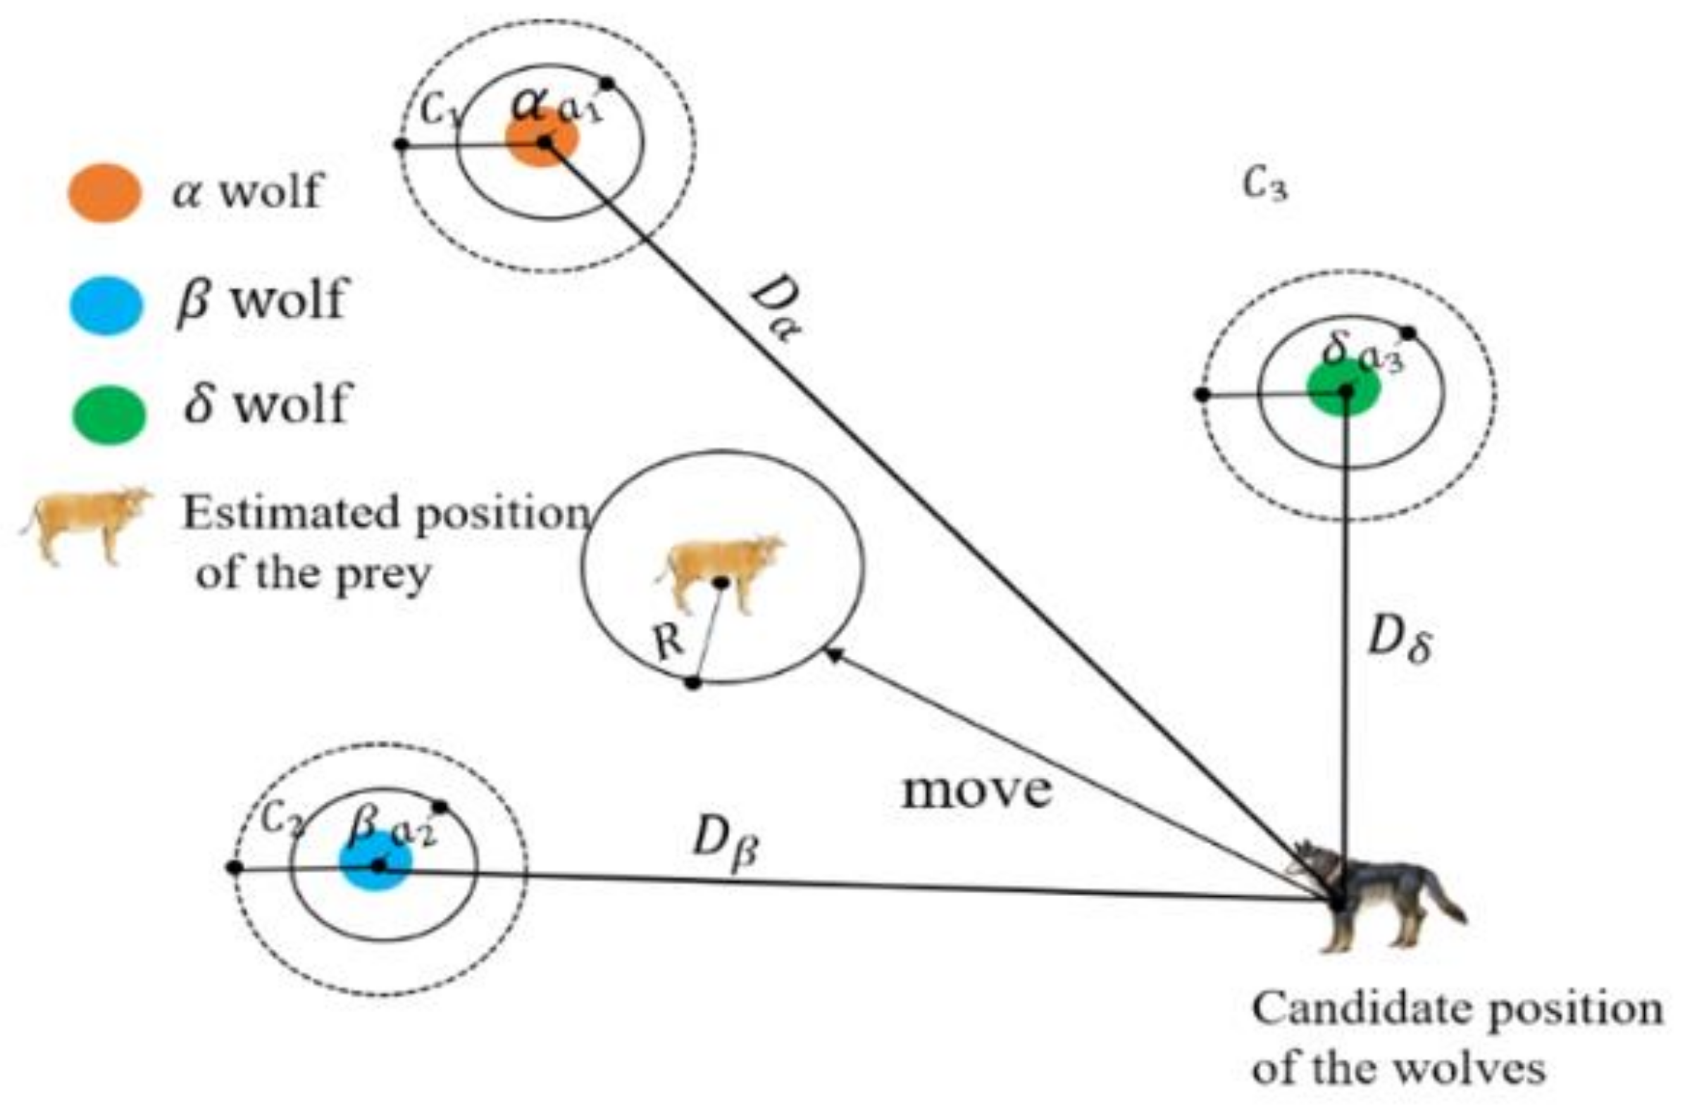

Slide 19
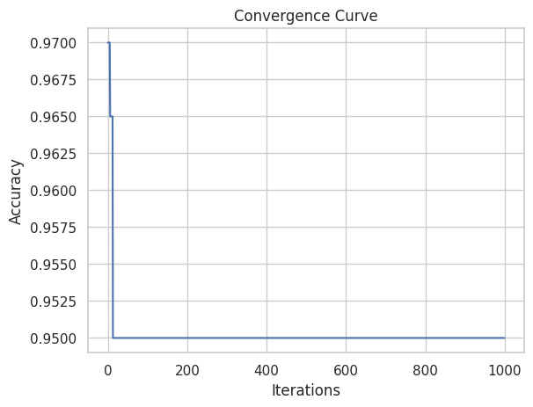

Slide 20
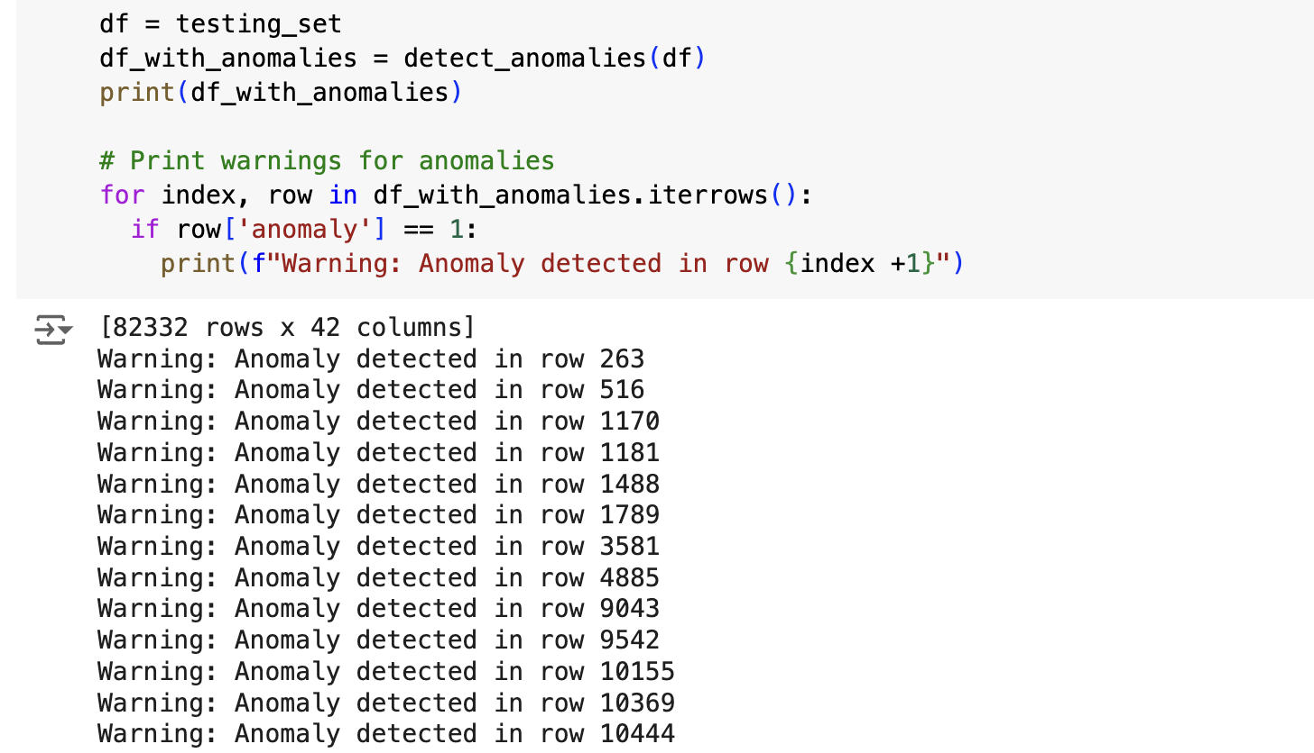

Slide 21

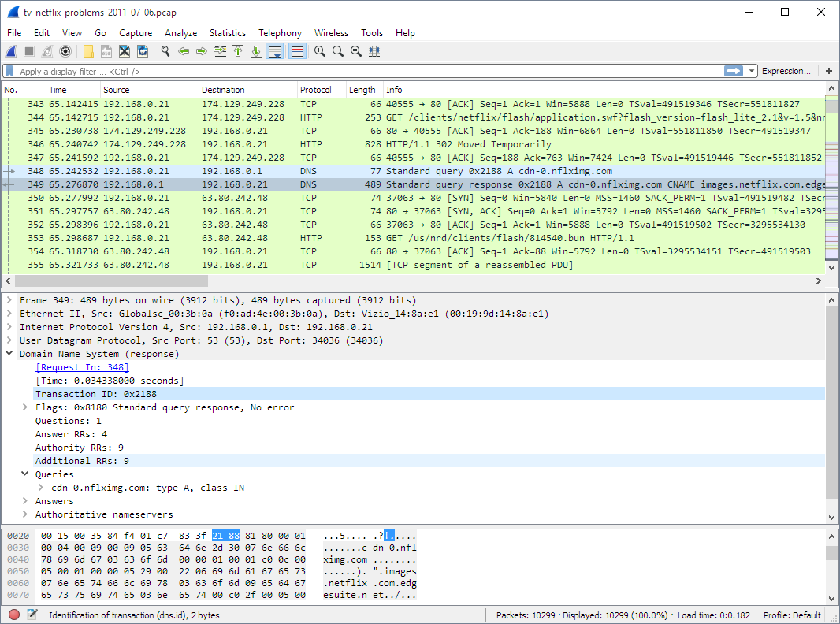
Save as ( testing_set.csv )
Wireshark
Capture network traffic
⚠️ WARNING:
To ensure legal compliance, avoid capturing network traffic on unauthorized networks.
Restrict your network capture to your own devices and local network.

Slide 22

Future Scope:

Slide 23
Train on more datasets to improve efficiency.
Combining Multiple Techniques: Integrating statistical, machine learning, and AI methods to leverage the strengths of each approach.
Implement Deep Learning models, such as recurrent neural networks (RNNs) and convolutional neural networks (CNNs), to capture complex temporal and spatial dependencies in network traffic.
Real-time data analysis: processing high-velocity network traffic streams in real-time.
Cloud-Based Solutions: cloud computing infrastructure to provide scalable and cost-effective anomaly detection services.
IoT Data: Incorporating data from IoT devices to identify anomalies in network behaviour.
Graph-Based Approaches: Modeling network traffic as graphs to capture relationships between devices and identify anomalies in network topology.

Slide 24
Thank You

Slide 25
Important resources
Github: https://github.com/salvinthilaks/Anomaly_Detection_in_Network
Google Colab : https://colab.research.google.com/drive/11Kbvm6aK_cCave80poOZIGoXCdyQCIHV?usp=sharing
Dataset :
TON_IoT Dataset - https://research.unsw.edu.au/projects/toniot-datasets
Canadian Institute for Cybersecurity - https://research.unsw.edu.au/projects/toniot-datasets

